Slide 1
Problems on Aggregate analysis
By
Gururaj
Assistant Professor-Selection Grade
Department of Computer Science & Engineering
M.I.T Manipal

Slide 2
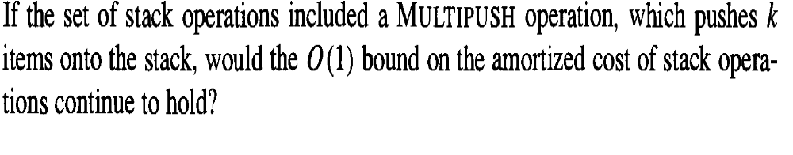
Exercise
No. The time complexity of such a series of operations depends on the number of pushes could be made. Since one MULTIPUSH needs Θ(k) time, performing n MULTIPUSH operations, each with k elements, would take Θ(kn) time, leading to amortized cost of Θ(k).

Slide 3
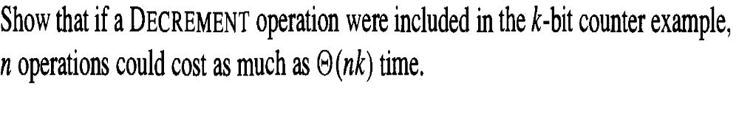
Exercise
Suppose we add a DECREMENT operation to the k-bit counter. With k bits, the INCREMENT operation is θ(k) in the worst case (flip all ones to zeroes). With DECREMENT, the worst case is also θ (k) (flip all zeroes to ones).
Ex:
0111 →1000

Slide 4
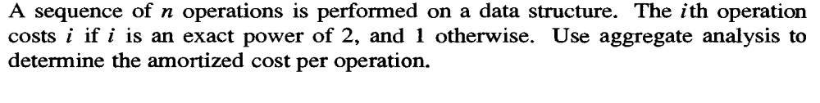
Exercise
In a sequence of n operations there are |log2 n|+1 exact powers of 2, namely 1,2,4,...,2 ^{|log2 n|} . The total cost of these is a geometric sum
The rest of the operations are cheap, each having a cost of 1, and there are less than n such operations.
The total cost of all operations is thus T(n) ≤ 2n+n = 3n = O(n), which means O(1) amortized cost per operation.

Slide 5
Exercise—Aggregate Analysis
Analyze the algorithm-finding the kth largest element in an array.
Algorithm Kth_largest(A, n, k) // k<=n
{
If (!sorted)
worst-case n log n
{ Merge_sort(A, n)
}
Return A[k]
Amortized cost= T(n)/n
= ( n log n + 1) + 1 + 1 + 1 + 1 ……..
First time access remaining n-1 time access
=(n log n + n)/n
=log n= O(log n)

Slide 6
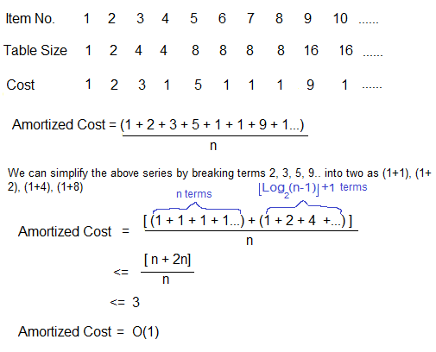
Analyze the algorithm- Dynamic hash table insertion for n elements

